Slide 1
Team 1
Chemquiz
Arun Ragavendhar Arunachalam Palaniyappan 104837257
Christopher Opie 105380202
Layan Buddhimal Weerasingha Arachchige 104758921
Amirajsinh Pradhyumansinh Sonagara 104801333
Henil Mukeshbhai Pistolwala 105065800

Slide 2
Amiraj
Log In page

Slide 3
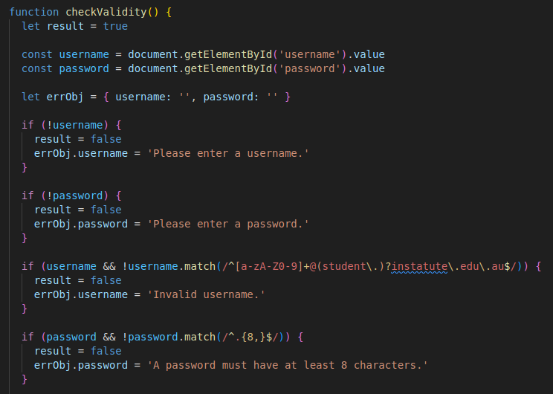
login.js

Slide 4
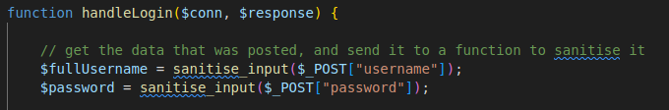
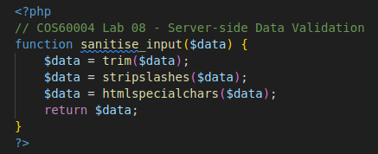
login.php
sanitiseinput.php

Slide 5
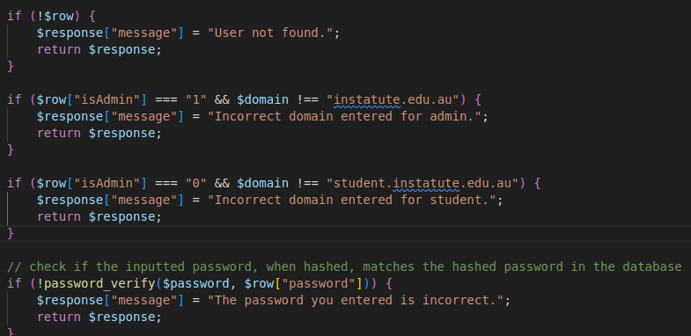
login.php

Slide 6
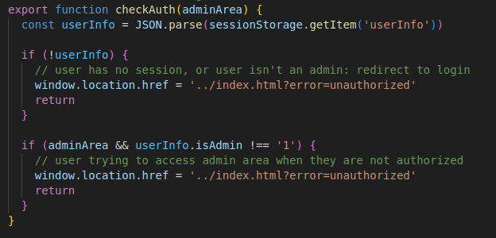
auth.js
3

Slide 7
Henil
Welcome lobby

Slide 8
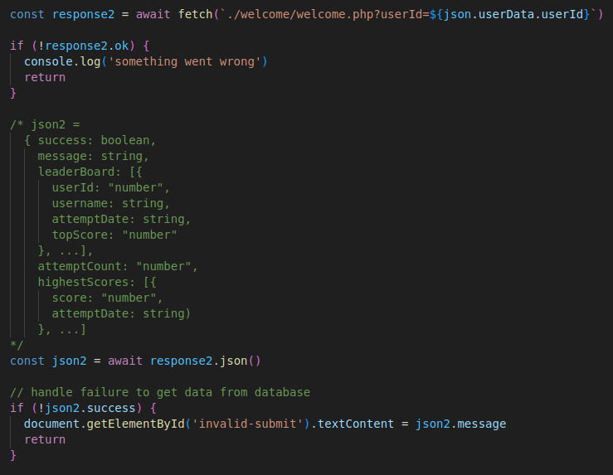
Login.js

Slide 9
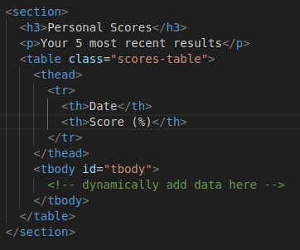
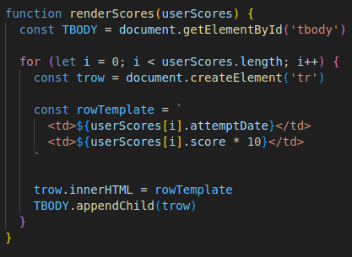
welcome.html
welcome.js

Slide 10
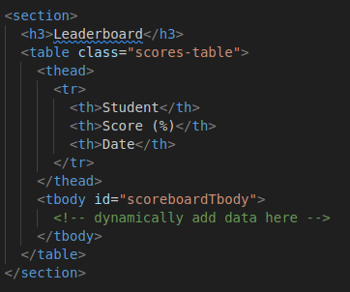
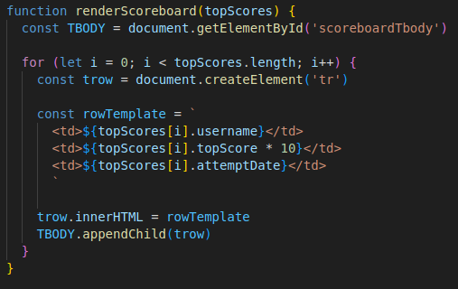
welcome.html
welcome.js

Slide 11
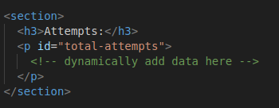
welcome.html
welcome.js

Slide 12
Layan
Admin: Users
Admin: Scores

Slide 13
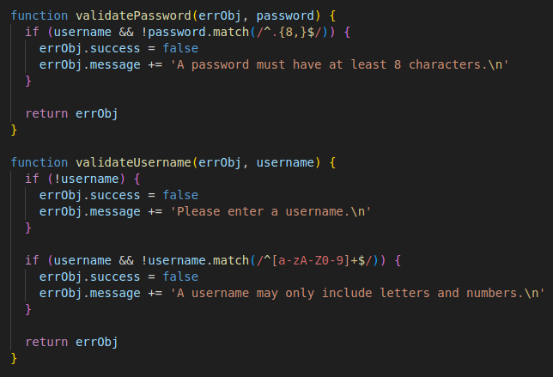
admin_users.js

Slide 14
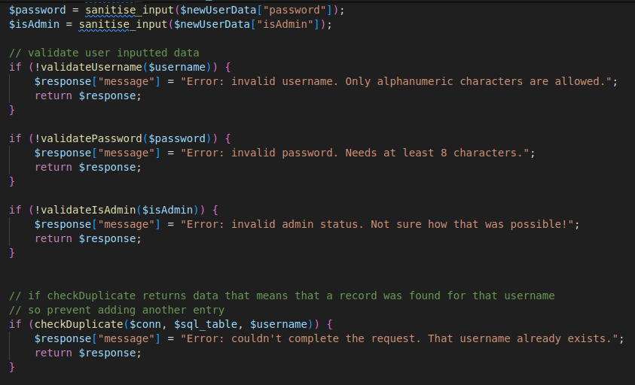
admin_users.php

Slide 15
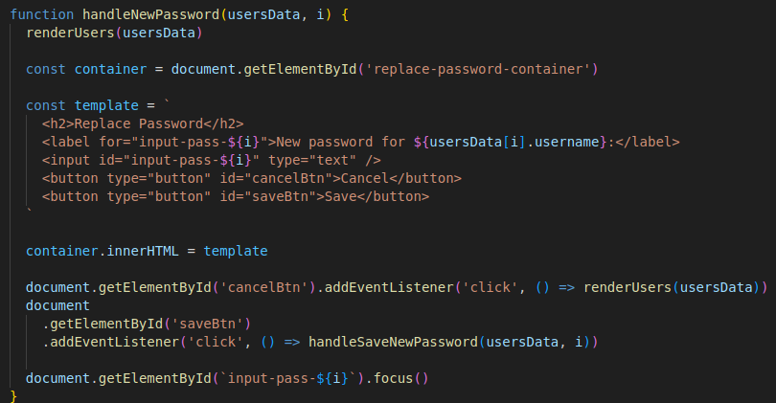
admin_users.js
3

Slide 16
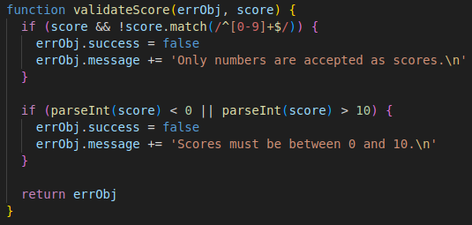
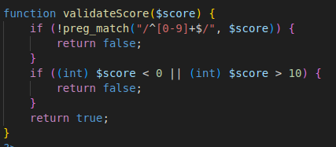
admin_scores.js
admin_scores.php

Slide 17
Chris Opie
Admin – Structure Questions
Admin – Reaction Qestions
Questions

Slide 18
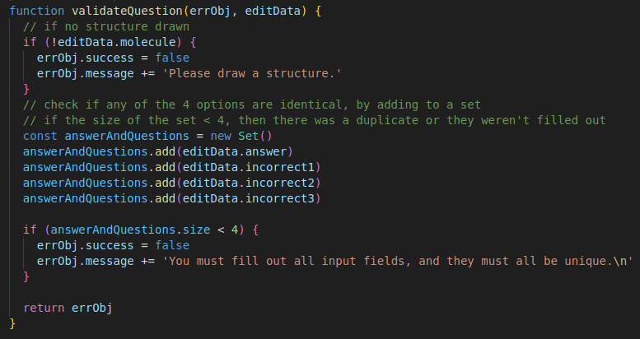
structure_questions.js

Slide 19
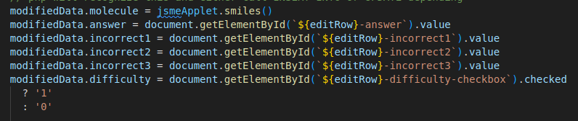
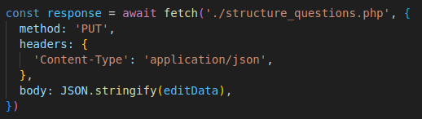
structure_questions.js
B. Bienfait and P. Ertl, JSME: a free molecule editor in JavaScript, J. Cheminformatics 5:24 (2013)

Slide 20
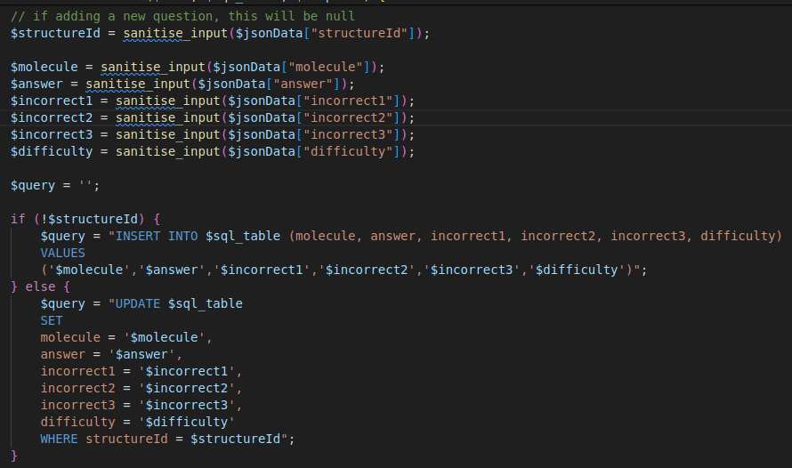
structure_questions.php

Slide 21
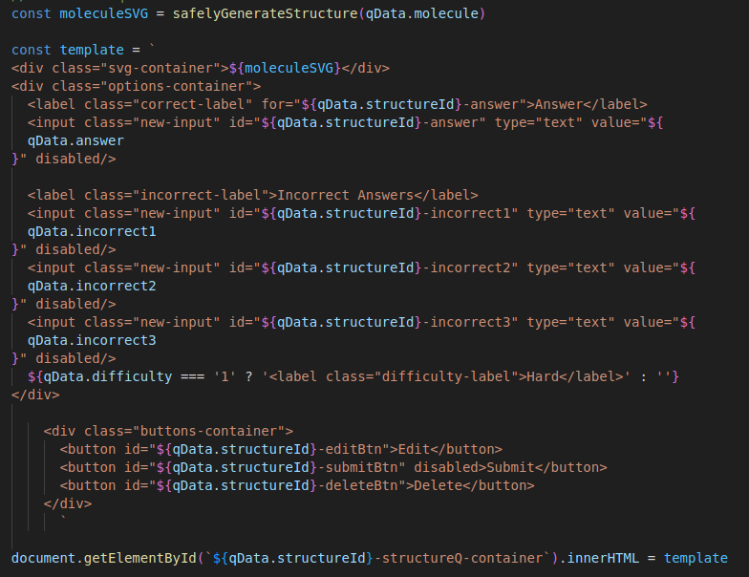
structure_questions.js
https://www.rdkitjs.com/

Slide 22
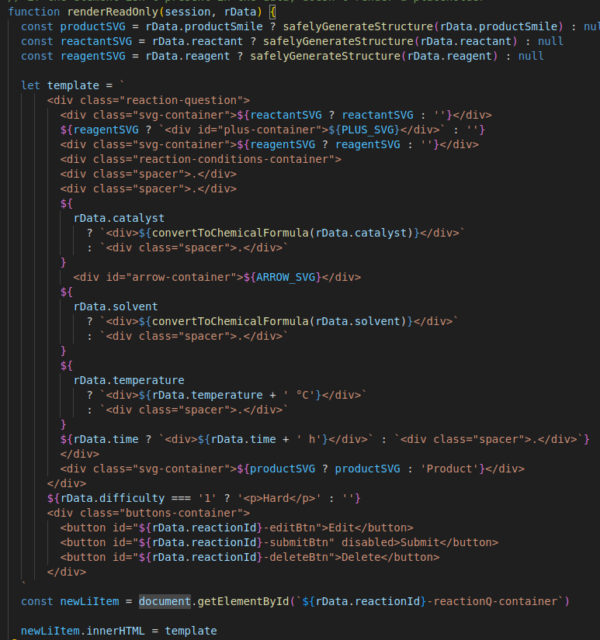
reaction_questions.js

Slide 23
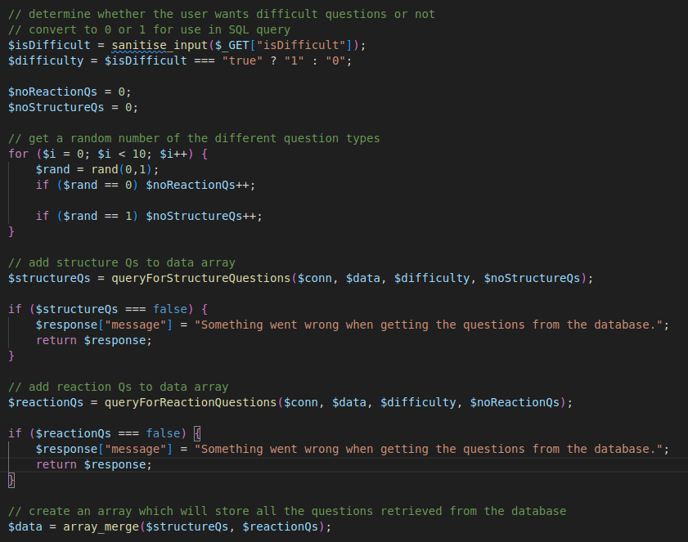
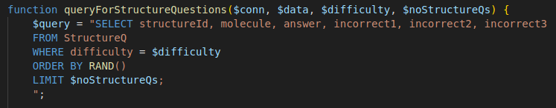
questions.php

Slide 24
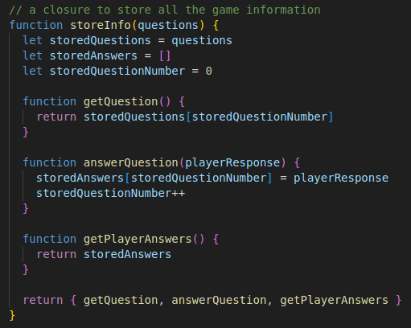
questions.js

Slide 25
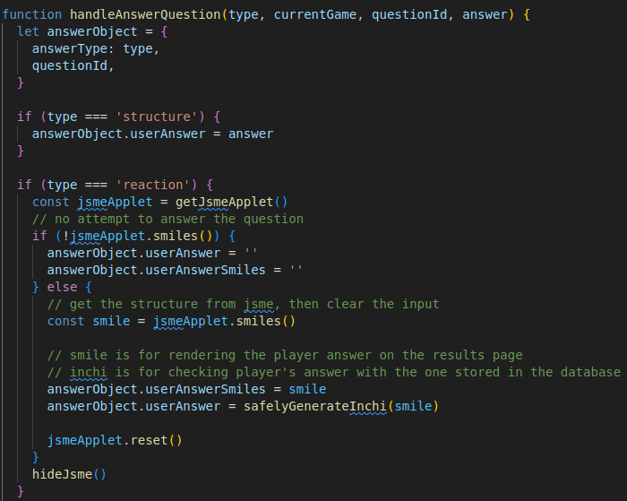
questions.js

Slide 26
Results Page
Arun Ragavendhar
104837257

Slide 27
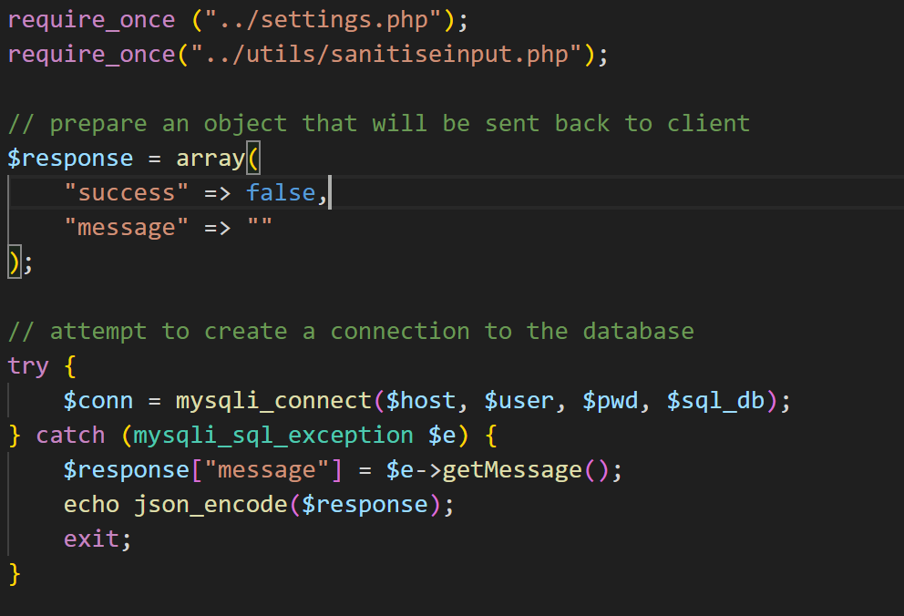
Technical Contributions and Functionalities Implemented

Slide 28
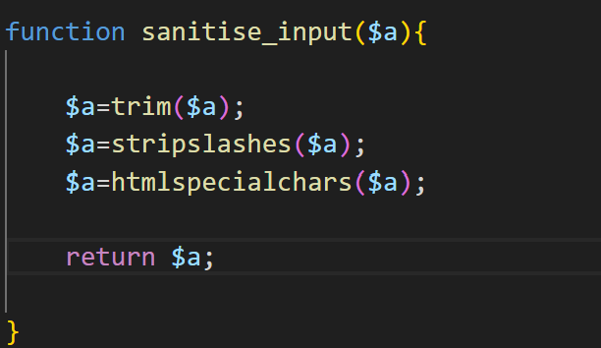
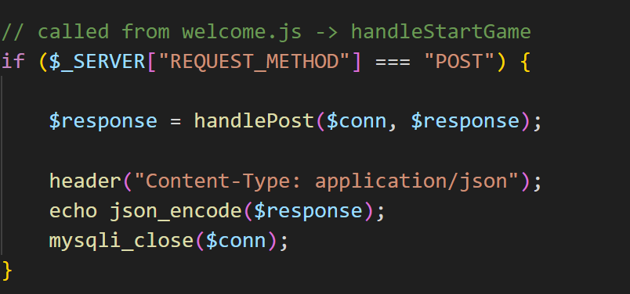
Technical Contributions and Functionalities Implemented

Slide 29
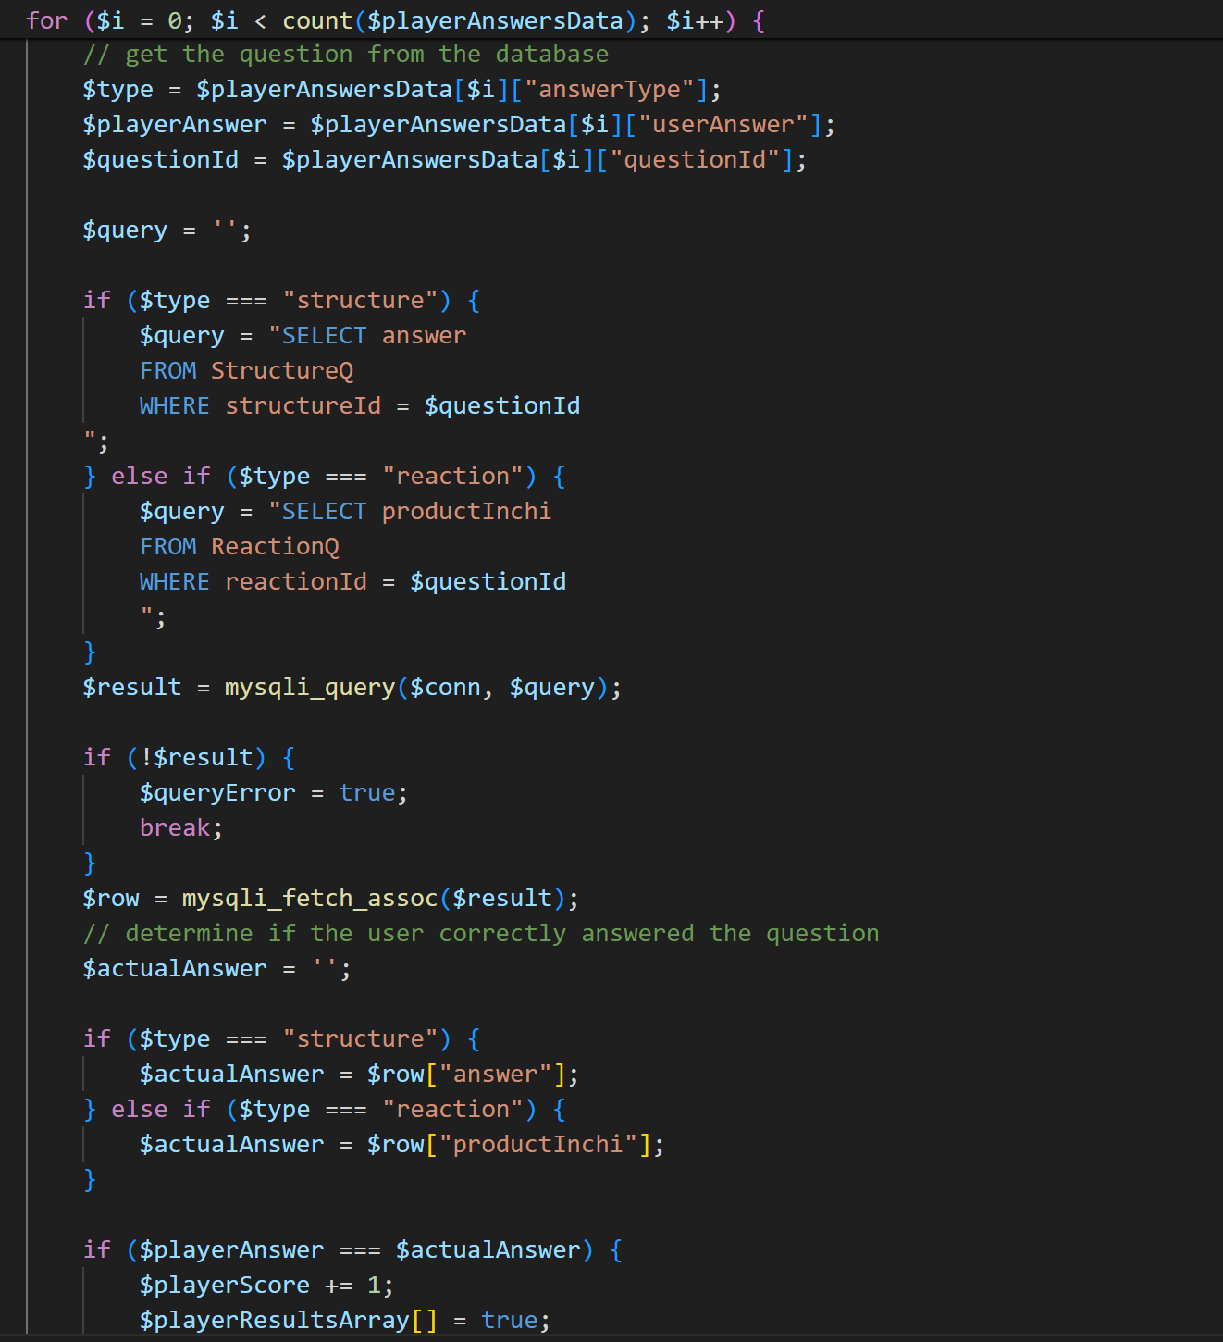
Technical Contributions and Functionalities Implemented

Slide 30
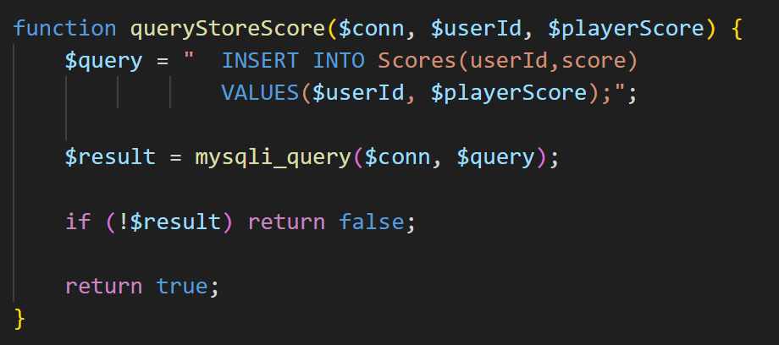
Technical Contributions and Functionalities Implemented

Slide 31
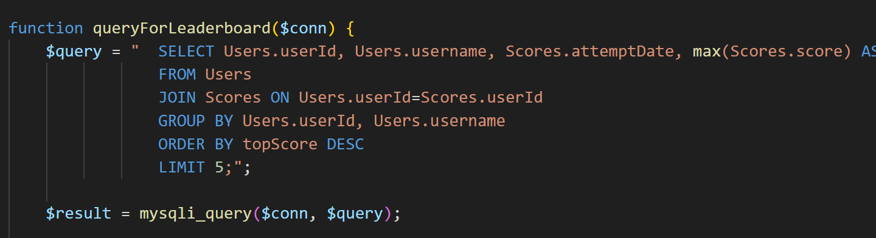
Technical Contributions and Functionalities Implemented

Slide 32
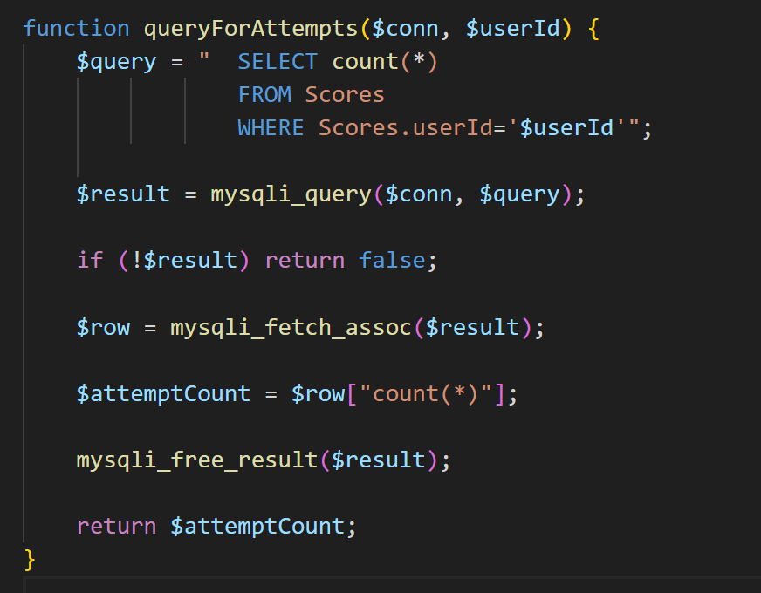
Technical Contributions and Functionalities Implemented

Slide 33
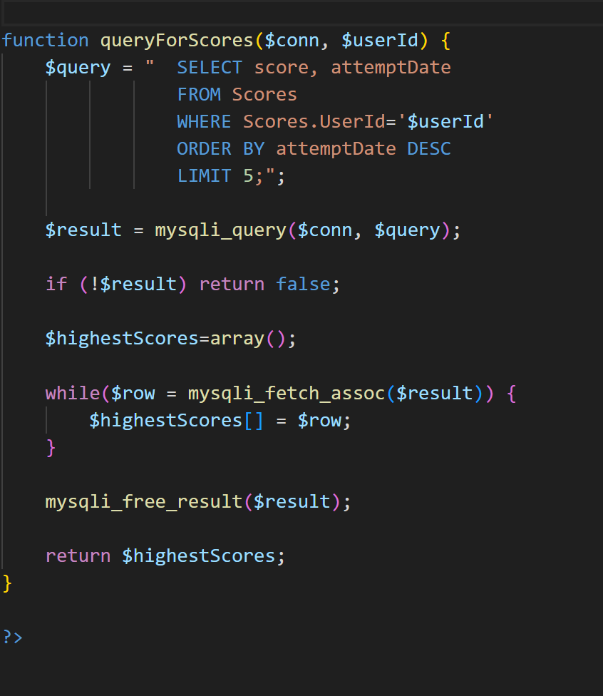
Technical Contributions and Functionalities Implemented

Slide 34
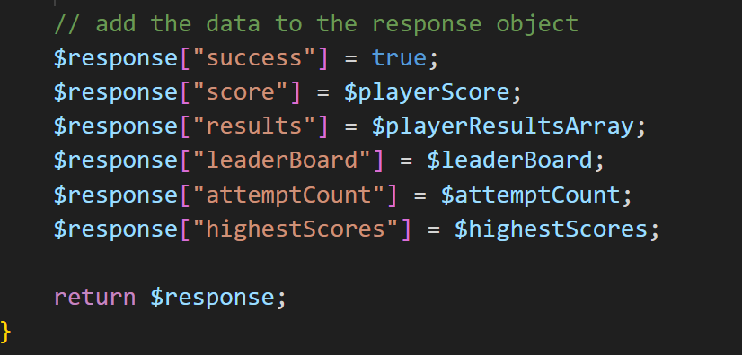
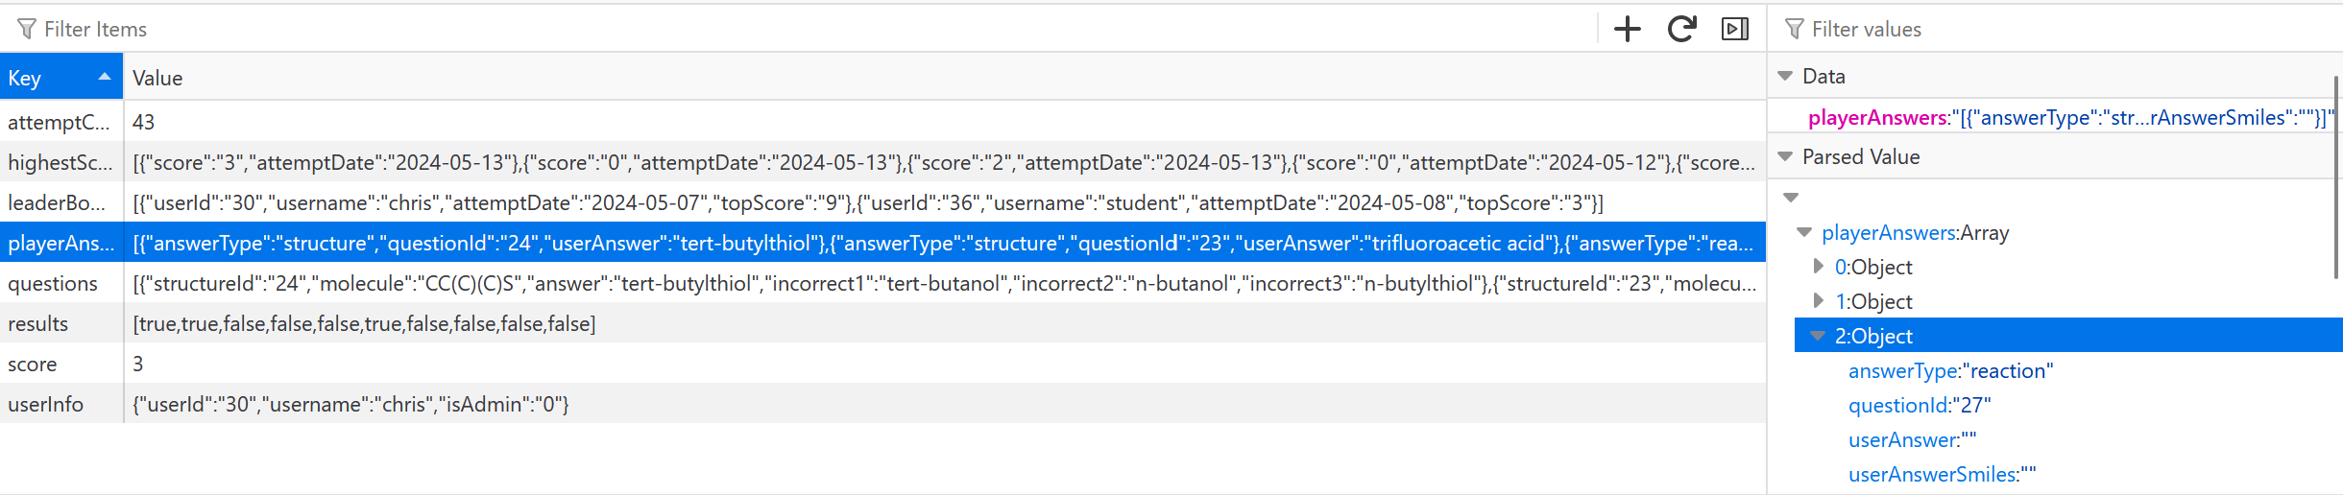
Technical Contributions and Functionalities Implemented

Slide 35
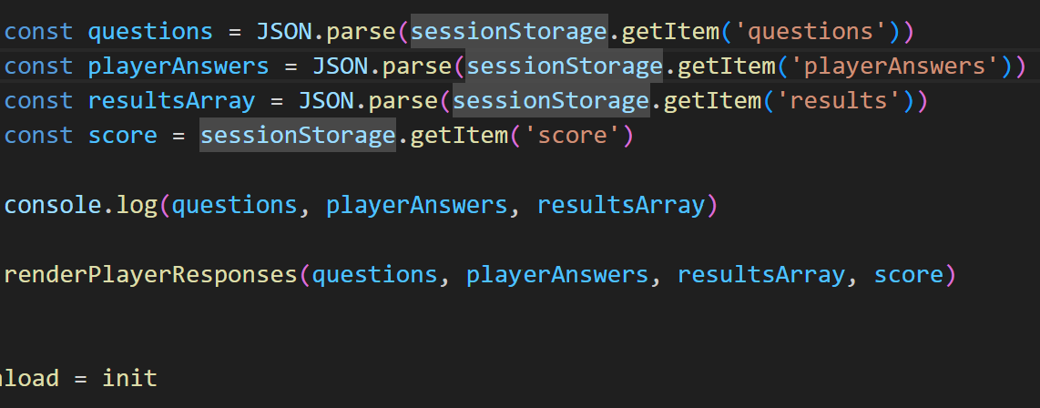
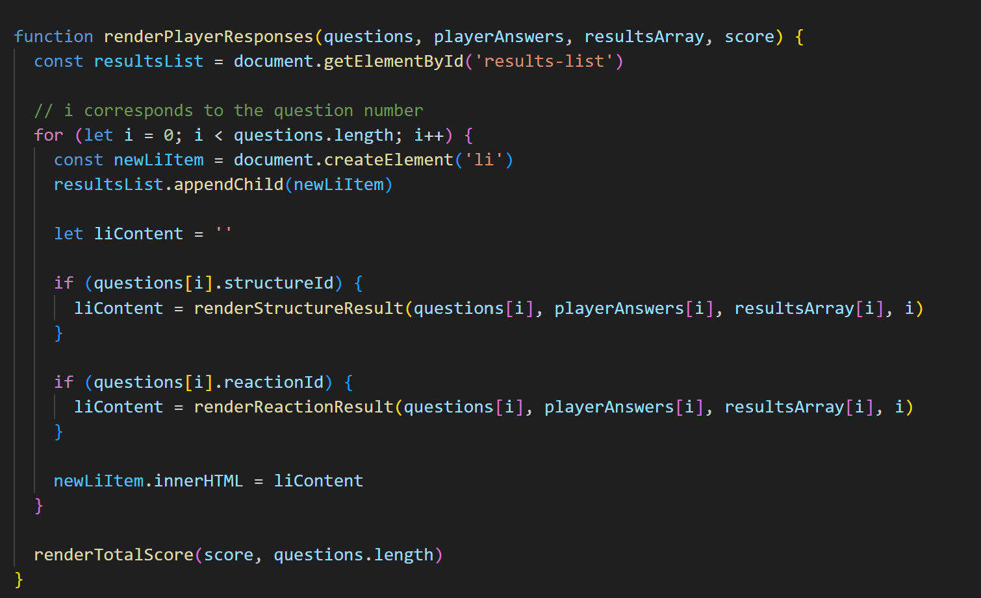
Technical Contributions and Functionalities Implemented

Slide 36
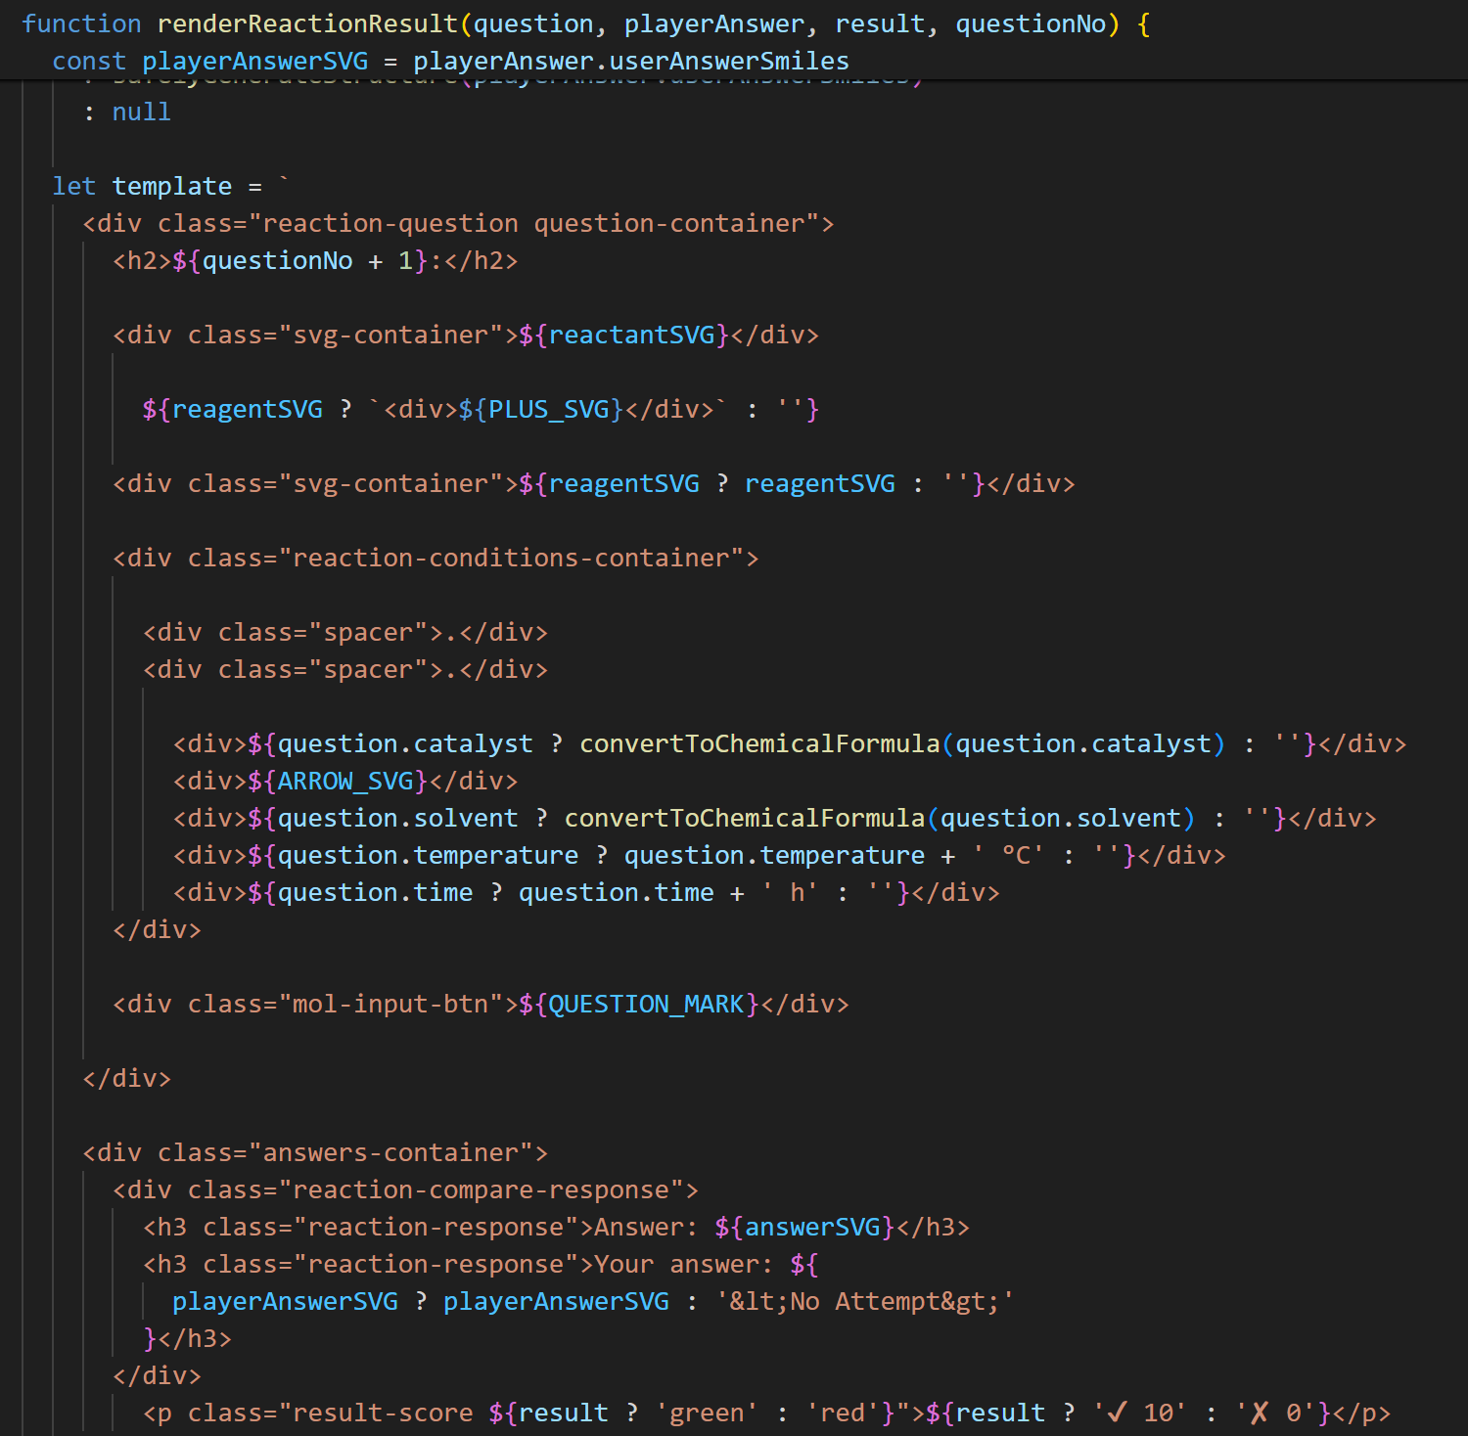
Technical Contributions and Functionalities Implemented

Slide 37
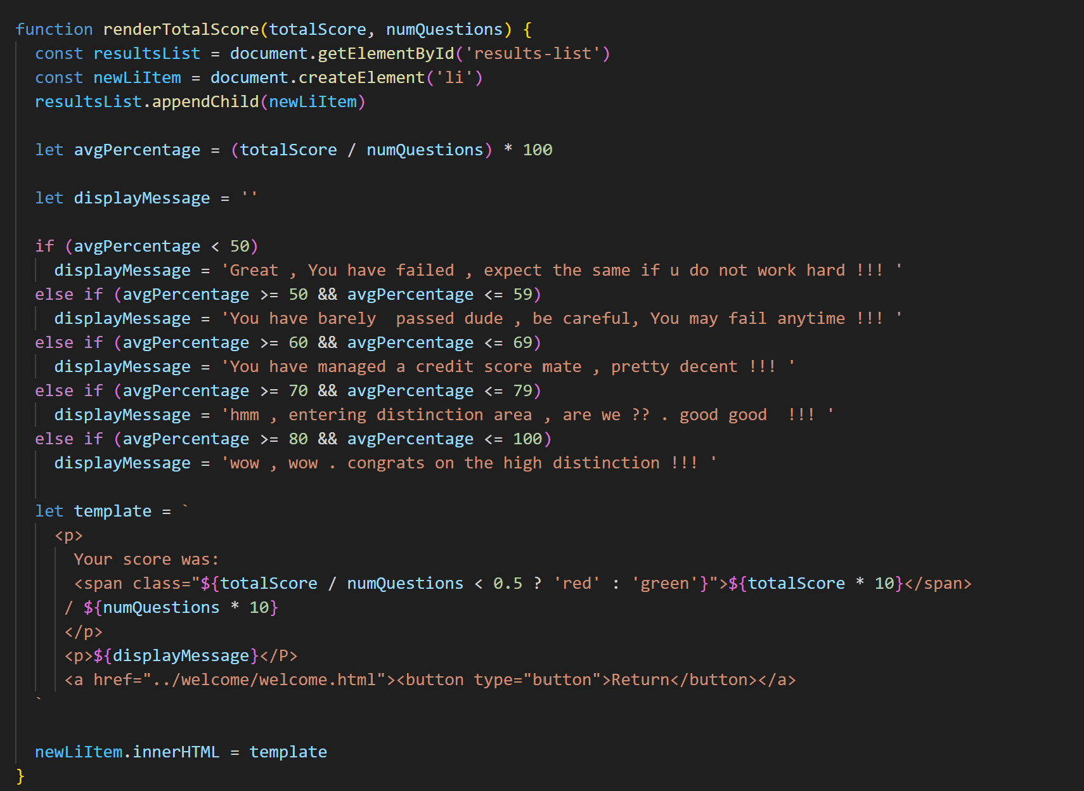
Technical Contributions and Functionalities Implemented

Slide 38
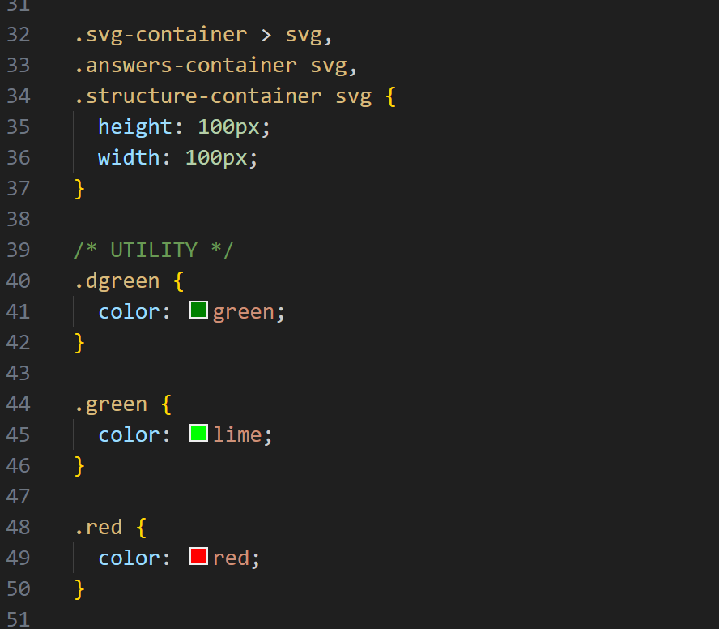
Technical Contributions and Functionalities Implemented

Slide 39
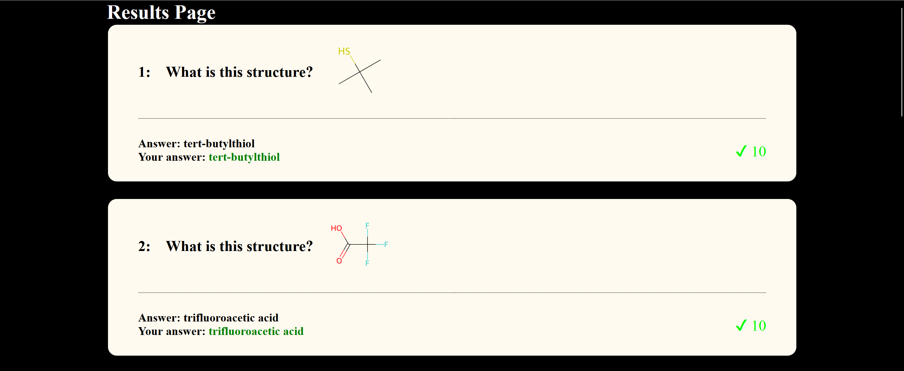
Technical Contributions and Functionalities Implemented
Final Output of results page

Slide 40
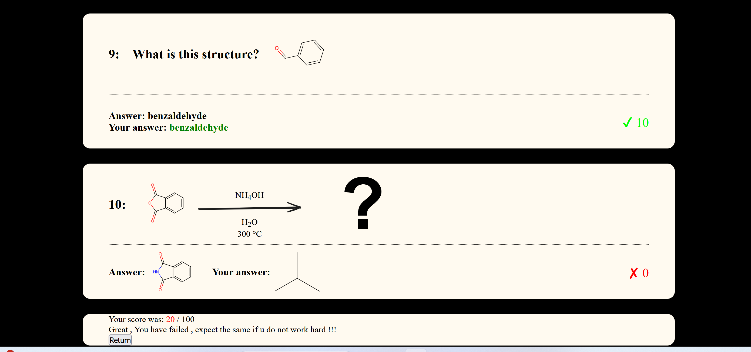
Technical Contributions and Functionalities Implemented

Slide 41
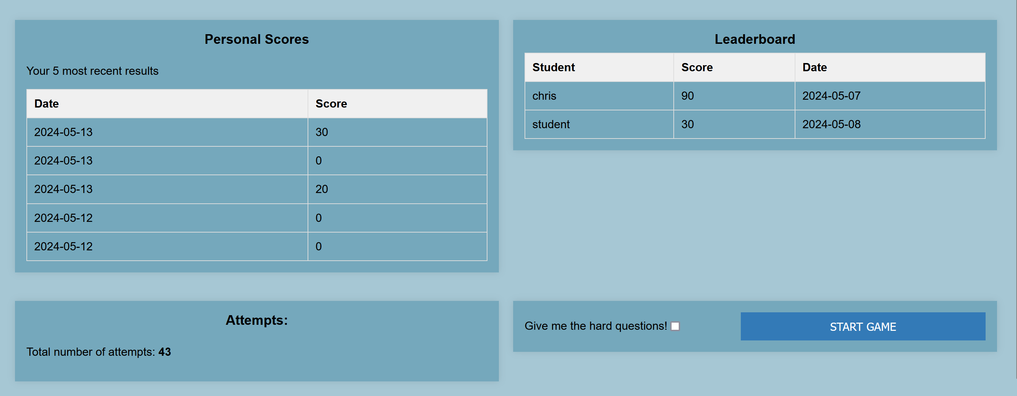
Technical Contributions and Functionalities Implemented

